Slide 1
Rococo: Extract more concurrency from distributed transactions
Shuai Mu, Yang Cui, Yang Zhang,Wyatt Lloyd, Jinyang Li
Tsinghua University, New York University,University of Southern California, Facebook

Slide 2
Outline
Introduction
ROCOCO
Evaluation
Conclusion

Slide 3
Introduction
What large web sites need ？
a distributed online transaction processing system
concurrency control to to guarantee strict serializability

Slide 4
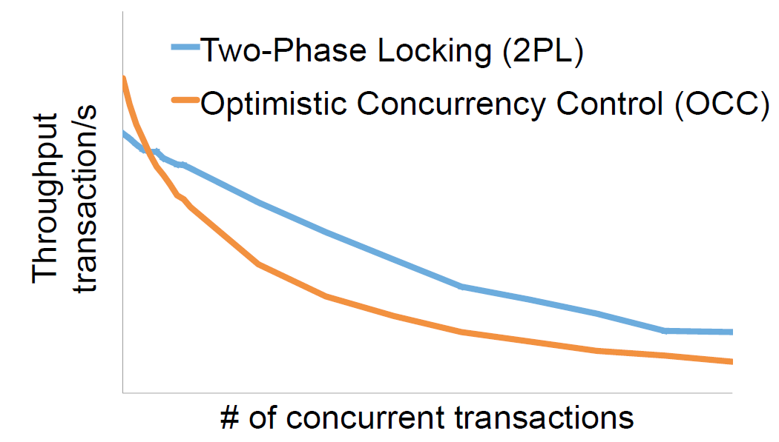
OCC&2PL
ROCOCO's GOAL: Achieve serializability w/o aborting or blocking for common workloads
Serializability is Costly under Contention

Slide 5


ROCOCO: Approach
ROCOCO(ReOrdering COnflicts for COncurrency)
if (strawberry > 0) {
strawberry--;
}
if (yogurt > 0) {
yogurt--;
}
if (strawberry > 0) {
strawberry--;
}
if (yogurt > 0) {
yogurt--;
}
if (strawberry > 0) {
strawberry--;
}
if (yogurt > 0) {
yogurt--;
}
if (yogurt > 0) {
yogurt--;
}
if (yogurt > 0) {
yogurt--;
}
if (strawberry > 0) {
strawberry--;
}
if (yogurt > 0) {
yogurt--;
}
strawberry=1
yogurt=1

Slide 6
ROCOCO: Key Techniques
Two-phase protocol
Most pieces are executed at the second(commit) phase
Start Phase
Send pieces to
servers w/o
executing them
Reorder for
serializability
Set up a
provisional order
Commit Phase
Establish a final
order and
execute pieces

Slide 7
ROCOCO: Key Techniques
Two-phase protocol
Most pieces are executed at the second(commit) phase
Enable piece reordering for serializability
Decentralized dependency tracking
Servers track pieces'arrival order
Identify non-serializable orders
Deterministically reorder pieces
Avoid aborts for common workloads
Offline workload checking
Identifies safe workloads (common)
Identifies small parts that need traditional approaches (rare)

Slide 8
ROCOCO: Start Phase
dep
dep
T1:
T2:
if ... strawberry--;
T2
T1
if ... strawberry--;
if ... yogurt--;
if ... yogurt--;
T1
T2
dep
dep
if ... strawberry--;
T1
if ... yogurt--;
T2
if ... strawberry--;
T2
if ... yogurt--;
T1
strawberry=1
yogurt=1

Slide 9
ROCOCO: Commit Phase
dep
dep
T2
Sort the cycle by an
deterministic order
T2
T2
T1
T1
T1
T1
T1
T2
T2
T1
T2
dep
dep
if ... strawberry--;
T1
if ... yogurt--;
if ... yogurt--;
T2
T2
if ... yogurt--;
T1
if ... strawberry--;
if ... yogurt--;
strawberry=1
yogurt=1

Slide 10

ROCOCO
Problem：Not Every Piece is Deferrable
oid=next_oid++
if ... strawberry--
if ... yogurt--
orderline.insert(oid,...)
next_oid
strawberry
yogurt
orderline
oid=next_oid++
if... strawberry--
if... yogurt--
oid
orderline.insert(
...)
oid

Slide 11
ROCOCO
Problem：Not Every Piece is Deferrable
a=next_a++;
b=next_b++;
ol_a.insert(a,...);
ol_b.insert(b,...);
a=next_a++;
b=next_b++;
ol_a.insert(a,...);
ol_b.insert(b,...);
next_a=0
next_a=0
1. Common workloads have few immediate pieces
2. Pre-known workload → Offline check
a=next_a++
b=next_b++
a=next_a++
b=next_b++

Slide 12
ROCOCO: Offline Checking
S(ibling)-edge linking
pieces within a transaction
T1
Item_Table
Item_Table
C(onflict)-edge
linking pieces w/
conflicting access
T2
Item_Table
Item_Table

Slide 13
ROCOCO: Offline Checking
T1
Oid_Table
Item_Table
Item_Table
T2
Oid_Table
Item_Table
Item_Table
Immediate
Deferrable
SC-cycles with deferrable pieces
can be safely reordered!

Slide 14
ROCOCO: Incorporating Immediate Pieces
oid
oid
Every cycle contains deferrable pieces, ensured by offline checking
A cycle with
deferrable pieces is safe to reorder
strawberry
strawberry
yogurt
yogurt
orderline
orderline
oid
strawberry
strawberry
yogurt
orderline
orderline
orderline
strawberry
yogurt
orderline
oid
strawberry
dep
dep
dep
dep
T2
T1
T1
T2
T2
T1
T1
T2
Immediate
dependency
Deferrable
dependency
next_oid
strawberry
yoghurt
orderline

Slide 15
ROCOCO: Summary
Key Techniques
Two-phase protocol
Decentralized dependency tracking
Offline checking
Other Details
Fault tolerance
Merge pieces
Read-only transaction
... ...

Slide 16
Evaluation
How does ROCOCO perform under contention?
How does ROCOCO scale?

Slide 17
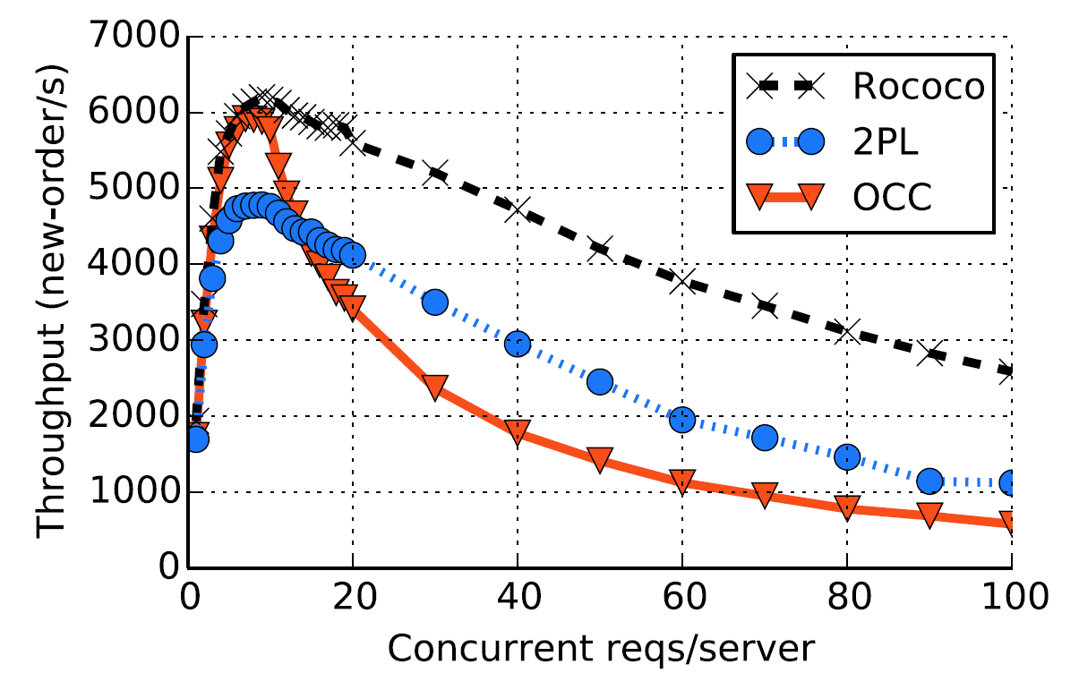
Evaluation

Slide 18
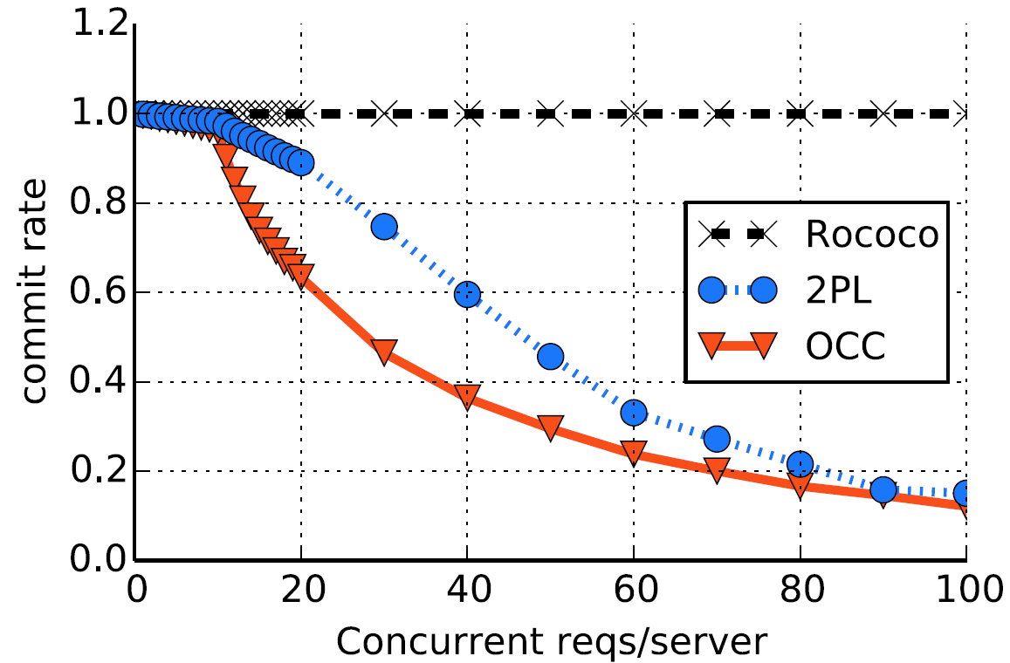
Evaluation

Slide 19
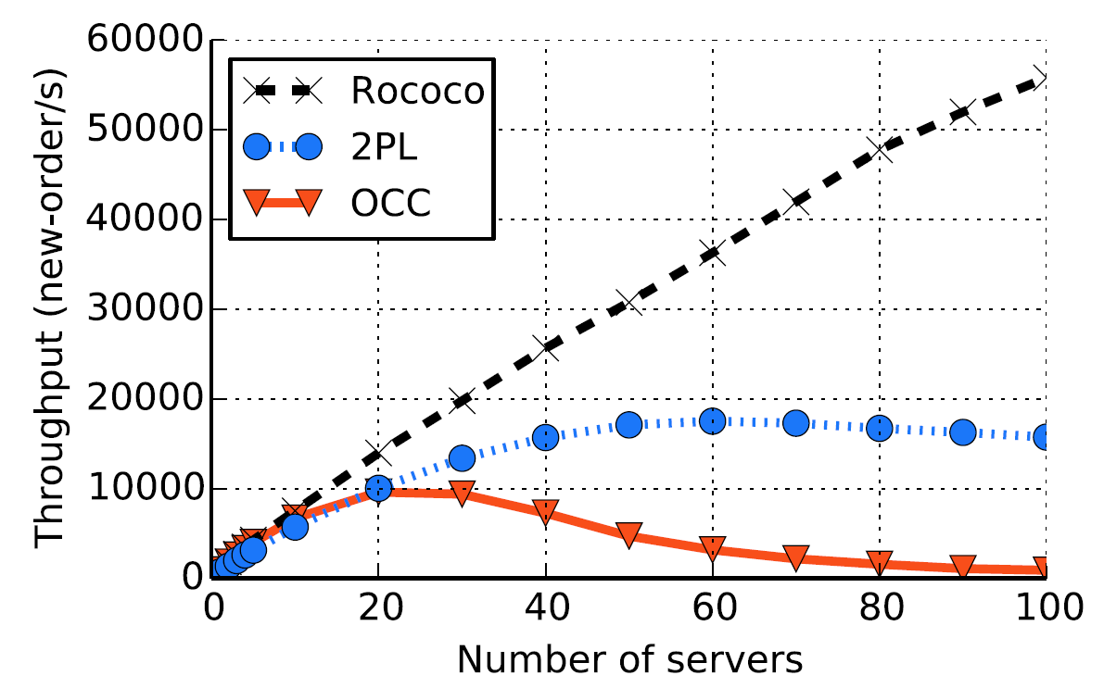
Evaluation

Slide 20
Conclusion
Traditional protocols perform poorly w/ contention
OCC aborts & 2PL blocks
Rococo defers execution to enable reordering
Achieve strict serializability w/o aborting or blocking for common workloads
Rococo outperforms 2PL & OCC
With growing contention
Scales out

Slide 21

Q&A

